Slide 1
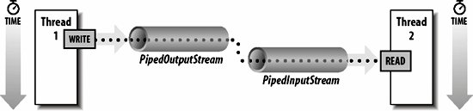
Java PipedReader and PipedWriter classes
The java.io.PipedReader class and java.io.PipedWriter classes provide a convenient means to move data from one thread to another. Output from one thread becomes input for the other thread.
The PipedReader and PipedWriter classes can be used to read and write data simultaneously. Both streams are connected with each other using the connect() method of the PipedWriter class.
PipedWriter is Piped character-output streams and PipedReader is Piped character-input streams.
PipedWriter
PipedReader

Slide 2
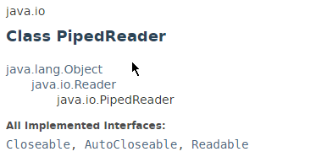
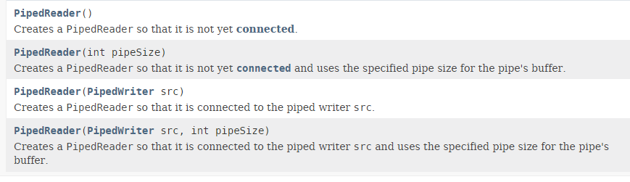
Java PipedReader and PipedWriter classes

Slide 3
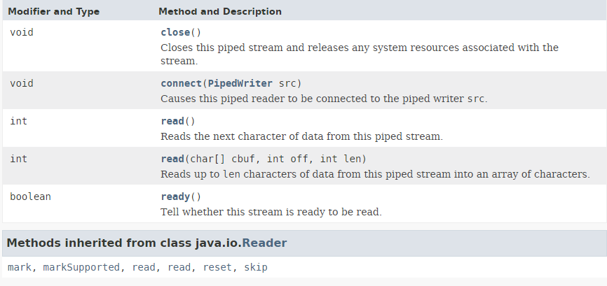
Java PipedReader and PipedWriter classes

Slide 4
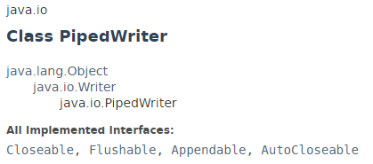
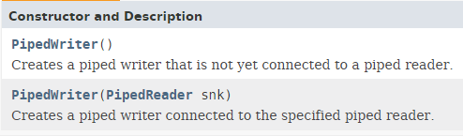
Java PipedReader and PipedWriter classes

Slide 5
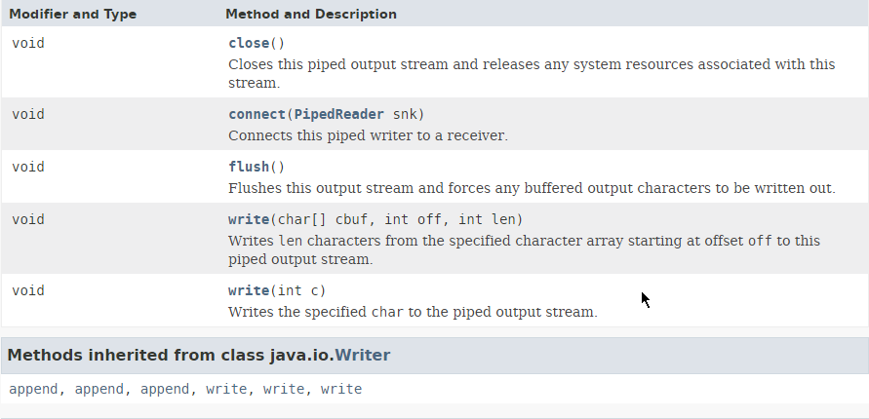
Java PipedReader and PipedWriter classes

Slide 6
Java PipedReader and PipedWriter classes
https://docs.oracle.com/javase/8/docs/api/index.html?java/io/PipedReader.html
https://docs.oracle.com/javase/8/docs/api/index.html?java/io/PipedWriter.html

